Slide 1



F
I
R
S
T
C
O
R
N
A
N
I
T
H
I
S
16.1-24
A free CD of this message will be available following the service
It will also be available for podcast later this week at calvaryokc.com

Slide 2
Matt. 6.21 - For where your treasure is, there your heart will be also.
O
A
N
S
16.1-24
I
I
F
I
R
S
T
C
R
N
T
H

Slide 3
1 Cor. 15.58 - Therefore, my beloved brethren, be steadfast, immovable, always abounding in the work of the Lord, knowing that your labor is not in vain in the Lord.
O
A
N
S
16.1-24
I
I
F
I
R
S
T
C
R
N
T
H

Slide 4
The Five “S's” of Stewardship
1. Systematic - 1st day of the week
Prosper (v. 2 - euodoō, good way or path)
O
A
N
S
16.1-24
I
I
F
I
R
S
T
C
R
N
T
H

Slide 5
The Five “S's” of Stewardship
2. Sacred – It’s an act of worship
Phil 4.18 - Indeed I have all and abound. I am full, having received from Epaphroditus the things sent from you, a sweet-
O
A
N
S
16.1-24
I
I
F
I
R
S
T
C
R
N
T
H

Slide 6
The Five “S's” of Stewardship
2. Sacred – It’s an act of worship
smelling aroma, an acceptable sacrifice, well pleasing to God.
O
A
N
S
16.1-24
I
I
F
I
R
S
T
C
R
N
T
H

Slide 7
The Five “S's” of Stewardship
3. Sacrificial - Mark 12, widow's mite
Not 10% but 100%
Gift - (v. 3) charis (grace) – KJV, liberality
O
A
N
S
16.1-24
I
I
F
I
R
S
T
C
R
N
T
H

Slide 8
The Five “S's” of Stewardship
3. Sacrificial - Mark 12, widow's mite
Prov. 11.24 - There is one who scatters, yet increases more;
And there is one who withholds more than is right,
But it leads to poverty.
O
A
N
S
16.1-24
I
I
F
I
R
S
T
C
R
N
T
H

Slide 9
The Five “S's” of Stewardship
3. Sacrificial - Mark 12, widow's mite
When your outgo exceeds your income, then your upkeep is your downfall
O
A
N
S
16.1-24
I
I
F
I
R
S
T
C
R
N
T
H

Slide 10
The Five “S's” of Stewardship
4. Secret
Matt. 6:3-4 - ³ But when you do a charitable deed, do not let your left hand know what your right hand is doing, ⁴ that your charitable
O
A
N
S
16.1-24
I
I
F
I
R
S
T
C
R
N
T
H

Slide 11
The Five “S's” of Stewardship
4. Secret
deed may be in secret; and your Father who sees in secret will Himself reward you openly.
O
A
N
S
16.1-24
I
I
F
I
R
S
T
C
R
N
T
H

Slide 12
The Five “S's” of Stewardship
5. Spirited – hilaros
2 Cor. 9.7 - So let each one give as he purposes in his heart, not grudgingly or of necessity; for God loves a cheerful giver.
O
A
N
S
16.1-24
I
I
F
I
R
S
T
C
R
N
T
H

Slide 13
Acts 16.6-8 - ⁶ Now when they had gone through Phrygia and the region of Galatia, they were forbidden by the Holy Spirit to preach the word in Asia. ⁷ After they had come to Mysia, they tried to go into Bithynia, but
O
A
N
S
16.1-24
I
I
F
I
R
S
T
C
R
N
T
H

Slide 14
the Spirit did not permit them. ⁸ So passing by Mysia, they came down to Troas.
O
A
N
S
16.1-24
I
I
F
I
R
S
T
C
R
N
T
H

Slide 15
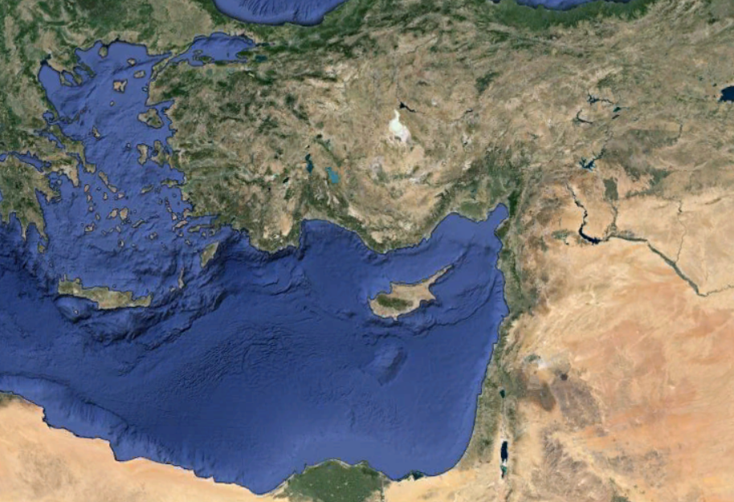
Bithynia
Troas
Asia
Corinth
Ephesus
Acts 16.6-8
O
A
N
S
16.1-24
I
I
F
I
R
S
T
C
R
N
T
H

Slide 16
Be brave -
NASB, act like men
KJV, quit ye like men
Literally, “make yourselves men” (middle voice)
O
A
N
S
16.1-24
I
I
F
I
R
S
T
C
R
N
T
H

Slide 17
William Barclay – “In the Christian life, there must be the courage which will never retreat and the love that will never fail.”
O
A
N
S
16.1-24
I
I
F
I
R
S
T
C
R
N
T
H

Slide 18
Devoted – KJV, addicted
To place in a certain order, to arrange, to assign a place, to appoint
O
A
N
S
16.1-24
I
I
F
I
R
S
T
C
R
N
T
H

Slide 19
Labors - kopiaō – to labor with wearisome effort
T. C. Edwards – “many work, but few toil”
O
A
N
S
16.1-24
I
I
F
I
R
S
T
C
R
N
T
H

Slide 20
Accursed - anathēma
O, Lord Come - Maranatha
O
A
N
S
16.1-24
I
I
F
I
R
S
T
C
R
N
T
H

